Slide 1
A Blisteringly-Fast Introduction to Test-Driven Development
Stephen K. Hess
2018/05/15

Slide 2

My History with TDD
Learned at Mapquest
JUnit, moved into Spock
Learned node.js+tape at Mapzen
John Flinchbaugh
TDD mentor
Sombrero enthusiast

Slide 3
What is Test-Driven Development?
Writing tests and code incrementally to fulfill product requirements that:
“Proves” functionality requirements (not mathematical proof)
Verifies behaviors of the code contract
Encourages simple design with rich test coverage
Treats the code under test as black box
Adds built-in documentation of functionality
Colloquially known as “unit testing”

Slide 4
Effects of Test-Driven Development
When TDD is practiced, the following effects are felt:
Refactoring becomes easier
Changes how you write code
Marginal increase in time spent coding
Dramatic decrease in time spent debugging
Iteration on new features is faster
Fewer implementation details to remember!
Easier for others to maintain (decrease in murderous rage)

Slide 5
What Does a Test Look Like?
function verifyABehavior() {
// Given (variables that have been setup)
// When (code under test is executed)
// Then (assert values of outputs and behaviors)
}

Slide 6
Starting Simple - Dividing 2 Numbers
function dividendShouldBeNumeratorDividedByDenominator() {
// Given
const numerator = 10
const denominator = 5
// When
const dividend = numerator / denominator
// Then
assert.equal(dividend, 2)
}

Slide 7
Writing Tests with Tape
const tape = require('tape')
tape('dividend should be numerator divided by denominators', test => {
// given
const numerator = 10
const denominator = 5
// when
const dividend = numerator / denominator
// then
test.equals(dividend, 2)
})

Slide 8
What is Tape?
Tape is a unit testing framework for Javascript. The following assertions are available:
ok() / notOk() - boolean conditions
equals() / notEquals() - simple comparisons
deepEquals() / notDeepEquals() - deep object comparisons
throws() / doesNotThrow() - negative tests

Slide 9
Function: Count Occurrences of a Letter in a String
Description:
Return number of instances of a letter in a string
Contract:
Accepts 2 parameters
First is string to count within
Second is character to count within first
If second parameter is not length 1, then return 0
Otherwise, return number of occurrences of second parameter in first parameter

Slide 10
Adding the First Test
Write a test to satisfy condition that when no second parameter is supplied (no character to count), then 0 should be returned.
tape('no second parameter should return 0', test => {
// Given
const countOccurences = require('./countOccurences')
// When
const count = countOccurences(‘abcba’)
// Then
test.equals(count, 0)
})

Slide 11
Coding for the First Test
Write just enough code to get the first test to pass (return 0 if second parameter is undefined):
function countOccurences(source, characterToCount) {
// passes the first test
if (undefined === characterToCount) {
return 0
}
}

Slide 12
Adding the Second Test
Write a test to satisfy condition that when second parameter length is greater than 1, then 0 should be returned.
tape('second parameter length > 1 should return 0', test => {
// Given
const countOccurences = require('./countOccurences')
// When
const count = countOccurences(‘abcba’, ‘aa’)
// Then
test.equals(count, 0)
})

Slide 13
Coding for the Second Test
Write just enough code to get the first test to pass (return 0 if second parameter has length > 1):
function countOccurences(source, characterToCount) {
// passes the first and second tests
if (undefined === characterToCount || characterToCount.length > 1) {
return 0
}
}

Slide 14
Adding the Third Test
Write a test to satisfy condition that when second parameter length is length 1, then the number of occurrences of it in the first string should be returned.
tape('second parameter length > 1 should return 0', test => {
// Given
const countOccurences = require('./countOccurences')
// When
const count = countOccurences(‘abcbabcba’, ‘b’)
// Then
test.equals(count, 4)
})

Slide 15
Coding for the Third Test
Write just enough code to get the third test to pass:
function countOccurences(source, characterToCount) {
// passes the first and second tests
if (undefined === characterToCount || characterToCount > 1) {
return 0
}
let count = 0
for (char in source) {
if (source[char] === characterToCount) {
count++
}
}
// passes the third test
return count
}

Slide 16
And We’re Done!
Description:
Return number of instances of a letter in a parameter
Contract:
✅ Accepts 2 parameters
First is string to count within
Second is character to count within first
✅ If second parameter is not length 1, otherwise return 0
✅ Otherwise, return number of occurrences of second parameter

Slide 17
Refactoring - Changing the Internals
Now that tests have been written, the implementation can change. As long as the tests pass, your code works!
function countOccurences(source, characterToCount) {
if (undefined === characterToCount || characterToCount > 1) {
return 0
}
// switch from for-loop to filter for fancier implementation
return source.split('').filter(c => c === characterToCount).length
}

Slide 18
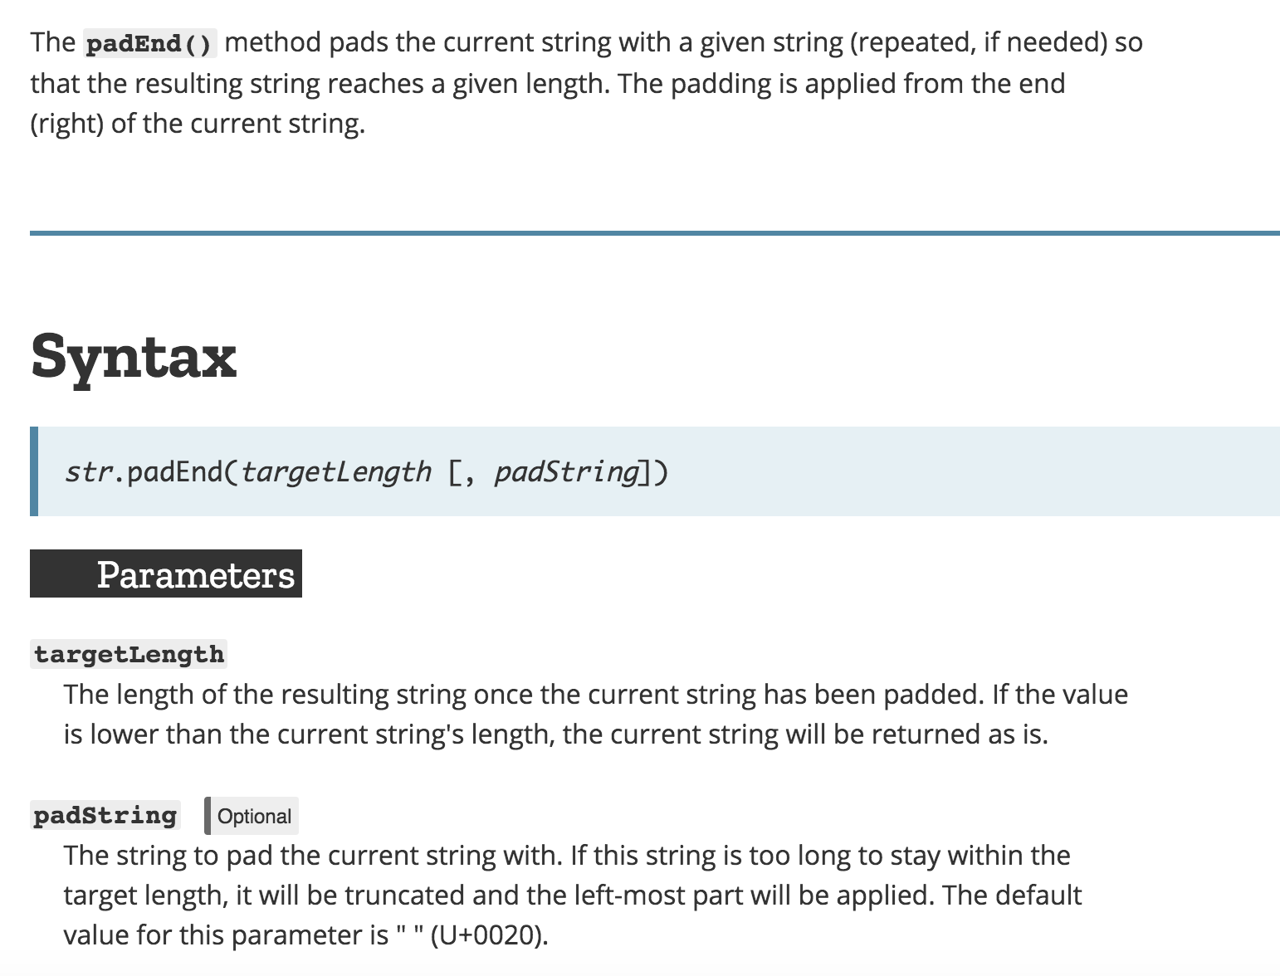
Black-box Testing - Discovering Functionality
Notes:
We wouldn’t normally test this sort of thing because it’s built into the language, but it’s interesting to see what happens with

Slide 19
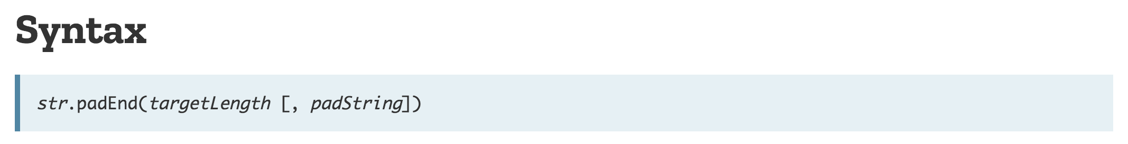
The Easy Part - Testing Common Inputs
// default padString should be a space
assert.equal('abc'.padEnd(5), 'abc ')
// explicit padString supplied
assert.equal('abc'.padEnd(5, '-'), 'abc--')
// multi-character padString
assert.equal('abc'.padEnd(6, '-!'), 'abc-!-')
// targetLength less than source string length
assert.equal('abc'.padEnd(2, '-'), 'abc')

Slide 20
Testing Uncommon Inputs
// zero-length input should return all padString
assert.equal(''.padEnd(5, '-'), '-----')
// padString should use to the toString() value
assert.equal('abc'.padEnd(9, true), 'abctruetr')
assert.equal('abc'.padEnd(9, [1, 2]), 'abc1,21,2')
assert.equal('abc'.padEnd(9, function() {}), 'abcfuncti')
Notes:
What behaviors do we see from this?

Slide 21
Testing Uncommoner Inputs
// negative targetLength should not cause error
assert.equal('abc'.padEnd(-5, '-'), 'abc')
// targetLength should be truncated to integer
assert.equal('abc'.padEnd(5.9, '-'), 'abc--')
// string targetLength should be massaged
assert.equal('abc'.padEnd('5', '-'), 'abc--')
// inadvertent toString() of single-element array should work
assert.equal('abc'.padEnd([5], '-'), 'abc--')
// NaN should be treated a source string length
assert.equal('abc'.padEnd(NaN, '-'), 'abc')
// no parameters should treated as a source length string with no padding
assert.equal('abc'.padEnd(), 'abc')

Slide 22
Negative Testing: Error Conditions
What happens when targetLength is Infinity?
> 'abc'.padEnd(Infinity, '-')
RangeError: Invalid string length
at String.padEnd (native)
This is testable behavior! But how?

Slide 23
Negative Testing: Error Conditions
> assert.throws(
function() {
'abc'.padEnd(Infinity, '-')
},
/^RangeError:/
)
The assertion to use
Function to test
Regexp matching error text

Slide 24
Negative Testing: Error Conditions
> assert.throws(
function() {
'abc'.padEnd(Infinity, '-')
},
/^RangeError:/
)
The assertion to use
Function to test
Regexp matching error text

Slide 25
Negative Testing: Error Conditions
> assert.throws(
function() {
'abc'.padEnd(Infinity, '-')
},
/^RangeError:/
)
The assertion to use
Function to test
Regexp matching error text

Slide 26
When Things Get Hard To Test
Code with tight couplings to services:
const pgDb = require('postgresql')
const queue = require('rabbit-mq')
function doSomeStuff(param1) {
// receive a message from the message queue
const message = queue.receive()
// insert it and param1 into the database
pgDb.exec('INSERT INTO table VALUES (${param1}, ${message})')
return pgDb.commit()
}

Slide 27
Testing For People Who Hate Themselves
function testDoSomeStuff() {
// Given
// 1. a bootstrapped database
// 2. a bootstrapped message queue
// 3. the function to test
const doSomeStuff = require('./doSomeStuff')
// When
const result = doSomeStuff('foobar')
// Then
// 1. select inserted values from database and assert
// 2. assert the return value from doSomeStuff()
// 3. assert that message queue no longer contains the message received
// And
// shut down the database
// shut down the message queue
}

Slide 28
Dependency Injection to the Rescue!
// inject the message queue and database functions
module.exports = function(receive, insert, commit) {
return function doSomeStuff(param1) {
// receive a message
const message = receive()
// insert it and param1 into the database
insert(param1, message)
return commit()
}
}
Benefits of dependency injection:
No “free reign” over database and message queue
Only injected functions need to be mocked
No longer tied to a specific database and message queue

Slide 29
Testing With Dependency Injection
function testDoSomeStuff() {
// Given
const receive = () => { return 'test message' }
const exec = (stmt) => { assert.equals(stmt,
'INSERT INTO table VALUES (“foobar”, “test message”)') }
const commit = () => { assert.ok(); return 17; }
const doSomeStuff = require('./doSomeStuff')(receive, insert, commit)
// When
const result = doSomeStuff('foobar')
// Then
assert.equal(result, 17, 'result of commit should be returned')
}

Slide 30
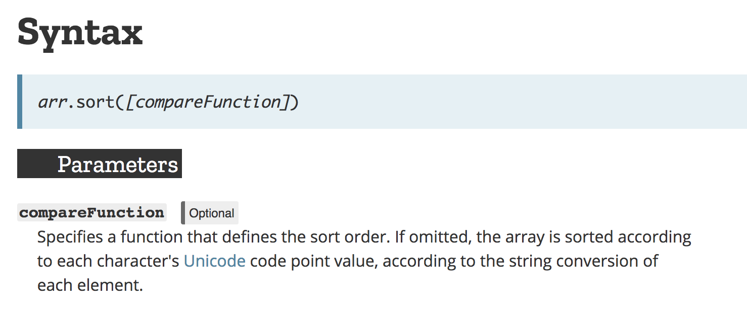
Dependency Injection in the Javascript API
The Array.sort function allows for injected comparator:

Slide 31
How Tugboat Practices TDD
Technologies used:
tape framework
tap-spec for reporting
proxyquire for dependency mocking
supertest for express routes
Jenkins for test running and deployment
Unit tests + Integration tests + Jenkins = Continuous Deployment!
Currently 2104 unit tests, but there’s opportunity for a lot more.

Slide 32
How to Practice TDD
My flow for writing code backed by tests:
10. Identify the most basic behavior
20. Write a test for that behavior
30. Watch that test fail
40. Write enough code to make that test pass
50. Refactor (optional)
60. GOTO 10 (until done)
70. You’re done!
This is called the red/green repeat cycle.

Slide 33
Characteristics of Good Unit Tests
Should test exactly one behavior
Should follow given/when/then flow
Should test unexpected inputs (edge and negative cases)
Run order should not matter (no side effects)
Test file has 1:1 correspondence with file under test
Don’t test methods only exposed for testing
Dependencies are injected
Should run quickly (that is, no longer than 1 minute for all tests)

Slide 34
Questions

